Slide 1
TESS & LEADS Implementation Awareness for End-of-Year Success
Office of Educator Effectiveness
Arkansas Department of Education
Spring, 2016

Slide 2
Every Student Succeeds Act (ESSA) Kindergarten to Post-Secondary
Every child deserves to be surrounded by a team of excellent educators every year….
If we want every student to succeed, it is vital that we surround them with the most effective teachers and leaders possible and support their ongoing work.
05/25
Notes:
Talk about legislation from 2011 and changes in 2013 and 2015… leading up to today.
States need measures to ensure low-income and minority students are not served at disproportionate rates by “ineffective, out-of-field, or inexperienced teachers“—with “ineffective” replacing “unqualified.”
ESSA focuses on teachers’ potential or demonstrable effectiveness in the classroom. States may begin to move away from input measures like teacher qualifications and toward output measures like evaluation data.
We are no longer under NCLB. There is still a lot of guidance that we need from the feds. The details have not been worked out. Under principle 3 Teacher and Leader.
We are no longer held to strict guidelines. Every student deserve a high quality, effective teacher. Put effective teachers and leaders in all schools in Arkansas.
We want teachers and leaders to grow.

Slide 3
Leadership Matters
The job of the principal has changed dramatically
Principals impact their students’ outcomes, particularly at the most challenging schools
Principal turnover adversely impacts schools
Effective principals retain and recruit effective teachers
Principals become more effective as they gain more experience
Being an instructional leader is the hallmark of effective principals
Notes:
http://www.centerforpubliceducation.org/principal-perspective
Which of these really speak to you? Talk about one of those statements.
Let members share.
Turnover is a problem.
Ts have to feel valued.
How is the supt. supporting principals.
Realities of today’s principalship

Slide 4
TESS and LEADS
How have I used TESS as a system of feedback and support to promote excellence for teachers in my building?
How have I used LEADS as a development system for myself?
Is there room for Improvement?
Notes:
Answer these questions let’s reflect on where we have come from this year.
How have I used it?
Feedback to the Ts.
Have the people share.
Think how is helping with professional development.
How have you been using LEADS to help your growth?
New leader standards are out and the state has not adopted yet. The ADE is looking at those.
We need to move from compliance.

Slide 5
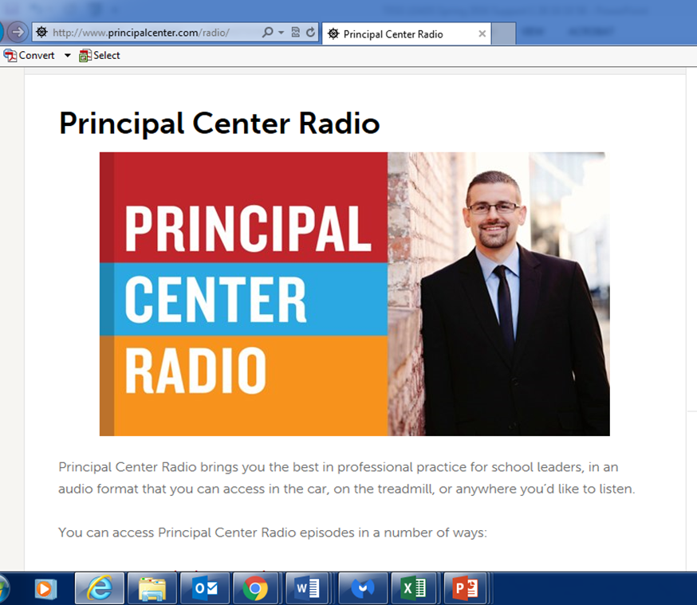
Notes:
Schools and Districts have an absolute obligation to ensure good teaching
Jot down key ideas that you hear from Justin and Charlotte.
What are some of the key points?
We want all to have access to quality Ts,. Here is how we know.
Importance of professional growth. We does that look like? Coversations with Ts,.
We identify needs and develop PGPs that help them with their work.
Danielson: the obj is to ensure good teaching. Here is how we know….FtT
The FfT is to promote learninbg and move to professional learning. In fact, the emphasis is on professional learning.
Principals and teachers can engage with their observers and have those productive conversations.
We have to have the right people on the bus

Slide 6
Needs Assessment
Not Started In Progress Completed
PGP Process
Track Placement
Training for new teachers to building
Informal
Artifacts
BloomBoard Marketplace
Formal Observations
Post Conferences
Mid-Year Review
Reviewed TESS data with Central Office Staff
Final Ratings
Tool for formal feedback to ADE
Notes:
Give them a few minutes to complete. Remind them this is for them to really get a handle on where they are in the process.
At the end of the day, we will provide you a live link to this so that you can offer feedback to the ADE.

Slide 7
TESS & LEADS Handbook
http://www.arkansased.gov/divisions/human-resources-educator-effectiveness-and-licensure/office-of-educator-effectiveness/teacher-evaluation-system

Slide 8
Feedback and Support Through Rating of Performance
Effective teachers or leaders
Evidence rather than opinion
Throughout the year to support and assist
Provide feedback on performance,
Validation of growth,
Point-in-time recognition of needs and accomplishments
Notes:
Thru ESSA we are focusing on effectiveness. Ratings go beyond a label. They are based on evidence…growth…progress…and point in time accomplishments.
Think about your very best teacher and write it down. Go into BloomBoard and look at their AE&R scores.
What does it take to be an effective teacher or an effective administrator. Conversation is critical.

Slide 9
LEADS and TESS Evidence Collection
Direct Observation | Indirect Observation | Artifacts | School Data
The evaluator is physically present in the school or venue where the school/district teacher or leader is present, leading and/or managing | The evaluator is observing systems that operate without the teacher or leader present | Materials that document the school/district leader’s practice | Teacher and student performance data, overall school performance data *Student/School Growth Data will not be included in 2015-16 Ratings
Notes:
Principal/School or District Supervisors must be in the building and must be interacting with principals
Activity—Pass out goals. What does evidence look like for these goals? Have a participant read the definition from the screen and then talk about each.
Each two has one goal to share. Examples are put on a Post-it note and then placed on the appropriate chart.
Use the tabs to see what proficient looks like from the rubric.
Take a pen and extra Post-it notes with you.
Read wwhat the other groups put. If you agree…check….if questioning put ?
Give one minute….If you think of something add a Post-it note….each group rotates….
District will determine if you will use state literacy or math assessments. If non-tested areas districts can develop its own assessment around defined criteria. You have to verify who is effective. ESSA gives you flexibility.

Slide 10
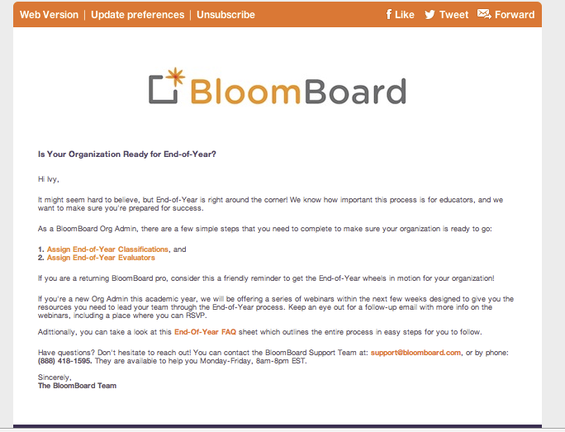
Notes:
BloomBoard Support <support@bloomboard.com>
Log in to account and scheduled a summative evaluation meeting

Slide 11
Annual Overall Rating
6.01 Annually in a summative evaluation (1, 2A, 3)year or an interim appraisal year(2Bs), a public school shall assign each teacher employed by the school an annual overall rating that is based on:
6.01.1 The teacher’s professional practice, as evidenced by the performance rating for a summative evaluation or for an interim appraisal; and
6.01.2 Student growth, as determined by rules promulgated by the State Board.
http://www.arkansased.gov/public/userfiles/rules/Current/TESS_Final_Rule_for_SBOE_2015_11_12.pdf
Notes:
Rules/Requirements for Ratings…
Remind that Ts are in tracks which determines
Remember student growth will in the 16-17 year…probably 17-18 will be the first year student achievement will be used.
Do Ss meet their expected growth.

Slide 12
What’s the Difference??
6.02.1 In a summative evaluation year, a Domain Average is derived from the average of all component scores in each domain of the evaluation framework. Each Domain Average is 25% of the Overall Weighted Score. Based on the Overall Weighted Score, the teacher is assigned a performance rating.
6.02.2 In an interim appraisal year, the performance rating used in the annual overall rating is derived only from the average of all components that align to the educator’s professional growth plan, regardless of the number in each domain. There is no Overall Weighted Score associated with an interim appraisal.
Notes:
Talk about time here… Amount of time spent with an Interim appraisal. How do you evaluate someone on just a few PGP components?
This is reflective of where we are.
The interim appraisal is an “evaluation that is lesser in scope”

Slide 13
Data Reported to the ADE
Aggregate School Ratings
TESS Only
Total Number of Teachers
Total Number Proficient/Distinguished
% Proficient/Distinguished
No individual educator data
Aggregate State Ratings
TESS (% Unsatisfactory, Basic, Proficient, Distinguished)
By Domain
By Component
Overall Ratings
LEADS (% NMS, Developing, Proficient, Advanced)
By Standard
By Function
Overall Ratings
Notes:
Explain that the data will be pulled. For LEADS there will only be state data,,,not at district level.

Slide 14
Share District Data with ADE
Option One
-Accept BloomBoard invitation to share your data with ADE (contains no identifiable individual information)
Option Two
-If invitation is not accepted, individual districts must complete the process themselves through an Excel spreadsheet
Option Three
-If data is not shared through Option One or Two, ADE will conduct site visits to districts to acquire the data
Notes:
ADE will not get nor receive individual ratings.

Slide 15
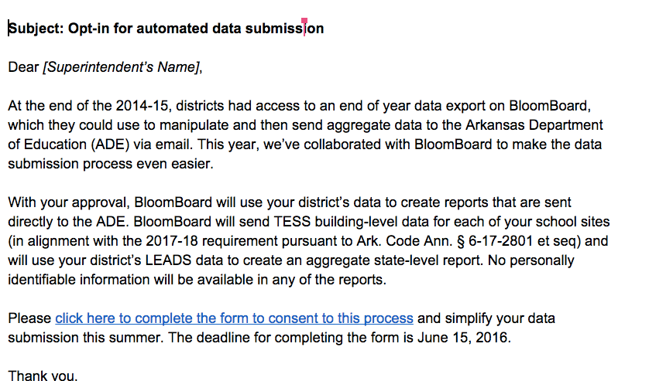
BloomBoard Communication
Notes:
Superintendents will receive this in March and the permission needs to be returned by May 2nd.

Slide 16
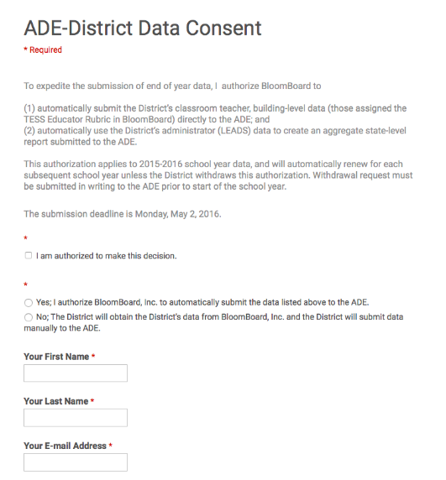
Consent Due By May 2

Slide 17
Deadlines and Submission Options
All Final Ratings must be in BloomBoard by June 30, 2016
Data will be pulled by BloomBoard and Reported to the Department of Education
With District Consent; otherwise, districts will have to aggregate their own data and submit to ADE by the deadline
Statewide aggregate data will be provided in updates during the summer
Statewide and District data will be used for support and professional development
Notes:
Data help us deter mine where help is needed.

Slide 18
BloomBoard Dashboard

Slide 19
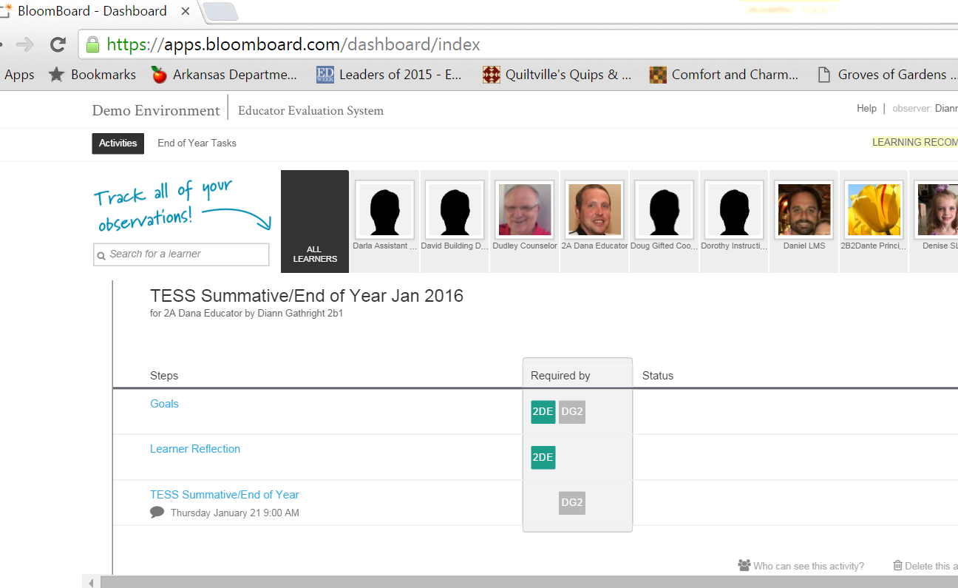
End of Year Protocol for End of Year Completion of Process
Notes:
Go into your BloomBoard

Slide 20
Use Blue Box for Goal Completion

Slide 21
End of Year Task

Slide 24
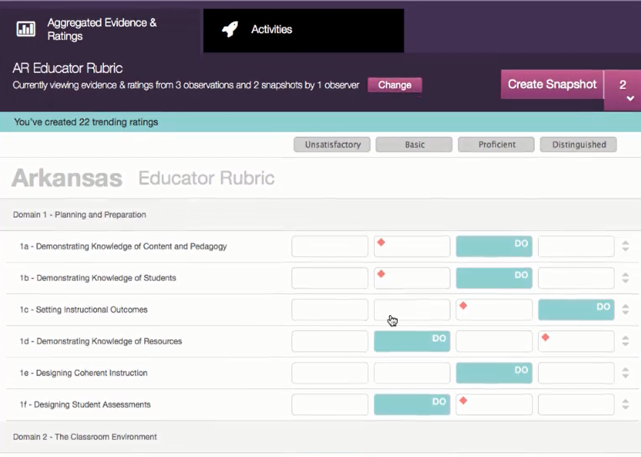
Notes:
Teacher self assessment. Novice and probationary teachers and teachers in Track 2A should complete this to help develop their PGP.

Slide 26
TESS/LEADS Implementation Tracker
https://www.surveymonkey.com/r/TESSLEADS2016
Provides local information to guide professional development, individual assistance for growth, identification of outstanding educators
Provides ADE information of statewide trends
Provides ADE information to provide technical assistance to districts

Slide 27
Meaningful Change in Practice
If we want teacher evaluation systems that teachers find meaningful and from which they can learn, we must use processes that not only are rigorous, valid, and reliable, but also engage teachers in those activities that promote learning—namely self-assessment, reflection on practice, and professional conversation.
Evaluations That Help Teachers Learn
Charlotte Danielson
Educational Leadership, December 2010

Slide 28
Contacts
Sandra Hurst, Director of Educator Effectiveness
Sandra.Hurst@arkansas.gov
Renee Nelson, Program Advisor
Renee.Nelson@arkansas.gov
Becky Gibson, Program Advisor
Becky.Gibson@arkansas.gov
Diann Gathright, State Trainer
Diann_Gathright@yahoo.com
Jim Johnson, State Trainer
Jim.Johnson629@yahoo.com

Slide 29
Need Extra Assistance Today?
PGPs
Additional Artifacts
End of Year Rating Process
Assigning Accounts
Where to find Archived Information

